Slide 1

Algebra 1
Unit 3, Lesson 6 Fitting Linear Functions to Data Volume 1, pg. 137

Slide 2


Benchmark
MA.912.DP.2.4
Fit a linear function to bivariate numerical data that suggests a linear association and interpret the slope and 𝑦-intercept of the model. Use the model to solve real-world problems in terms of the context of the data.
volume 1, pg. 137

Slide 3
Integrated Mathematical Thinking and Reasoning Standards
MA.K12.MTR.1.1 Actively participate in effortful learning both individually and collectively.
MA.K12.MTR.2.1 Demonstrate understanding by representing problems in multiple ways.
MA.K12.MTR.4.1 Engage in discussions that reflect on the mathematical thinking of self and others.
MA.K12.MTR.5.1 Use patterns and structure to help understand and connect mathematical concepts.
MA.K12.MTR.6.1 Assess the reasonableness of solutions.
MA.K12.MTR.7.1 Apply mathematics to real-world contexts.
volume 1, pg. 137

Slide 4

Learning Targets
I can formally fit a linear function to bivariate numerical data using technology.
I can relate the correlation coefficient to the slope and fit of a linear relationship between two variables.
volume 1, pg. 137

Slide 5

Warm-Up
volume 1, pg. 138

Slide 6
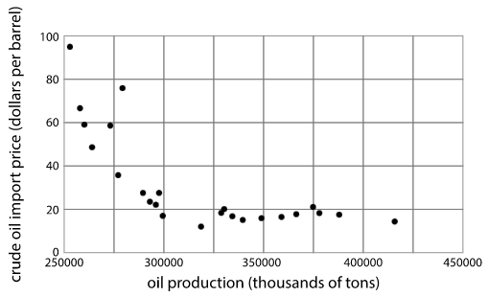
3.6.1 Warm-Up: Notice and Wonder
The scatter plot shows the relationship between oil production, in thousands of tons, and the crude oil import price, in dollars per barrel.
volume 1, pg. 138
Notes:
Video Link: https://algebranation.wistia.com/medias/fi4fidi5y8

Slide 7
Complete the table to indicate one thing you notice and one thing you wonder about when looking at this scatter plot.
One Thing I Notice is … | One Thing I Wonder is …
volume 1, pg. 138
Notes:
Video Link: https://algebranation.wistia.com/medias/fi4fidi5y8

Slide 8

Exploration
volume 1, pg. 138

Slide 9
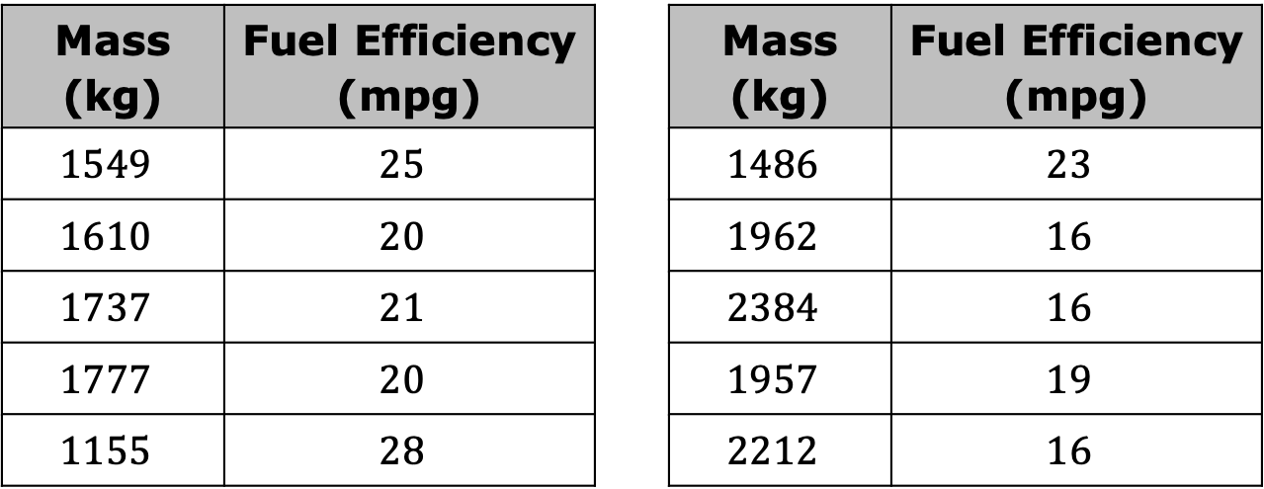
3.6.2 Exploration: Formally Fit a Linear Function to Bivariate Data Using Technology
The mass, in kilograms (kg), and fuel efficiency, in miles per gallon (mpg), of $20$ new gas-powered cars is given in the table.
Mass (kg) | Fuel Efficiency (mpg) |  | Mass (kg) | Fuel Efficiency (mpg)
$$1549$$ | $$25$$ |  | $$1486$$ | $$23$$
$$1610$$ | $$20$$ |  | $$1962$$ | $$16$$
$$1737$$ | $$21$$ |  | $$2384$$ | $$16$$
$$1777$$ | $$20$$ |  | $$1957$$ | $$19$$
$$1155$$ | $$28$$ |  | $$2212$$ | $$16$$
volume 1, pg. 138

Slide 10
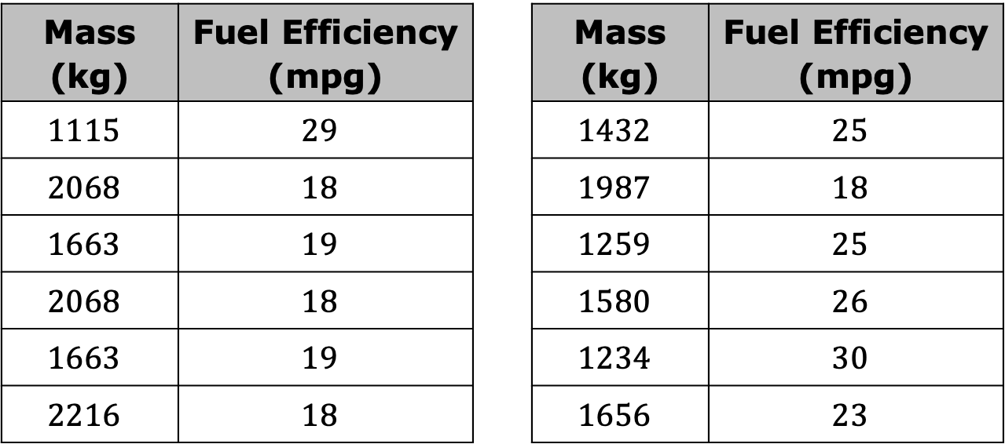
Mass (kg) | Fuel Efficiency (mpg) |  | Mass (kg) | Fuel Efficiency (mpg)
$$1115$$ | $$29$$ |  | $$1432$$ | $$25$$
$$2068$$ | $$18$$ |  | $$1987$$ | $$18$$
$$1663$$ | $$19$$ |  | $$1259$$ | $$25$$
$$2068$$ | $$18$$ |  | $$1580$$ | $$26$$
$$1663$$ | $$19$$ |  | $$1234$$ | $$30$$
$$2216$$ | $$18$$ |  | $$1656$$ | $$23$$
The raw data can be used to formally fit a line to model the relationship between the data using technology.
volume 1, pg. 138

Slide 11
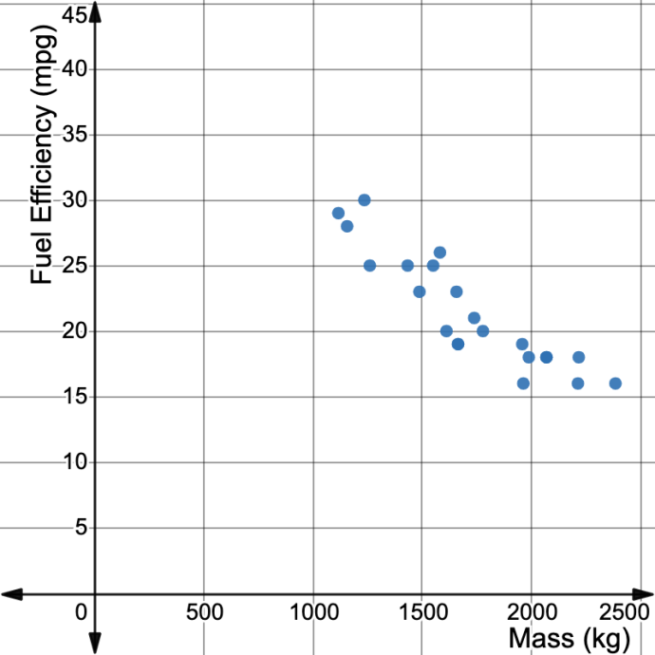
Tess created the scatter plot shown to represent the data using technology. Work with your partner to describe the pattern of association between a car’s mass and fuel efficiency.
volume 1, pg. 139

Slide 12
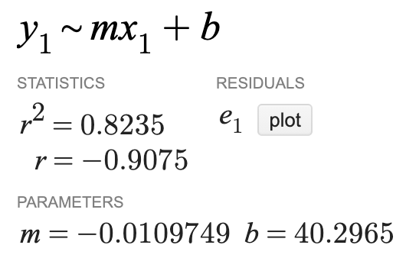
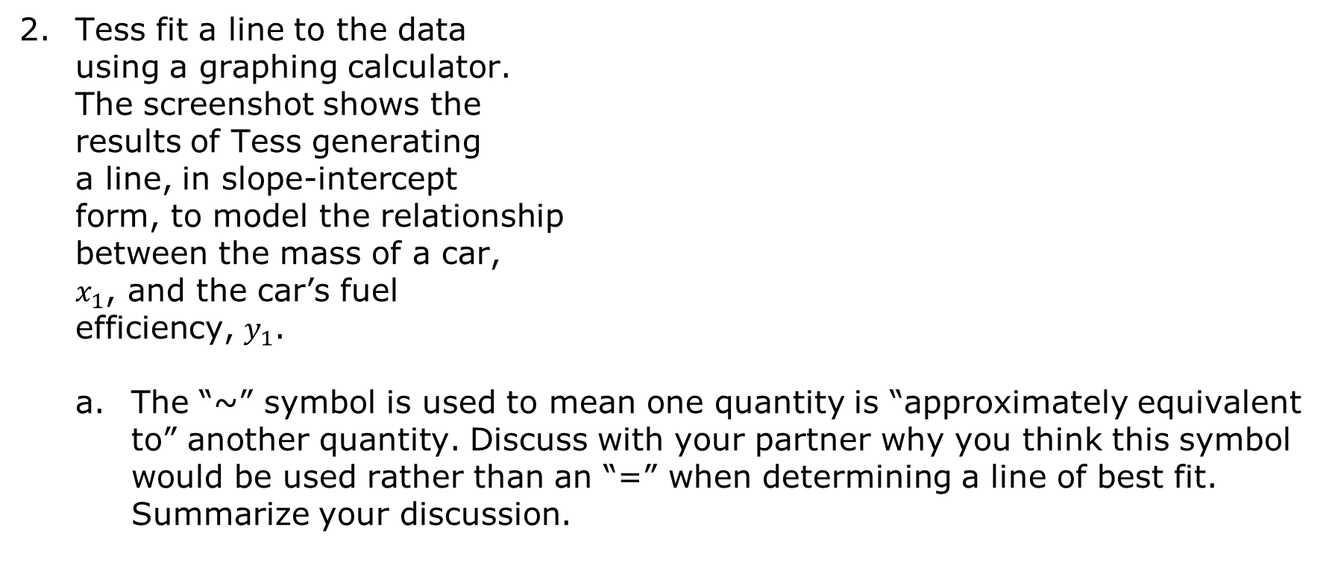
Tess fit a line to the data using a graphing calculator. The screenshot shows the results of Tess generating a line, in slope-intercept form, to model the relationship between the mass of a car, $x_{1}$, and the car’s fuel efficiency, $y_{1}$.
The “~” symbol is used to mean one quantity is “approximately equivalent to” another quantity. Discuss with your partner why you think this symbol would be used rather than an “=” when determining a line of best fit. Summarize your discussion.
volume 1, pg. 139

Slide 13
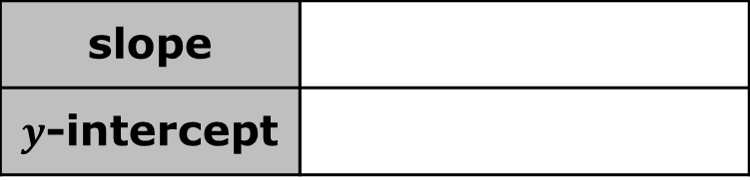
According to the screenshot, what are the slope and 𝑦-intercept of the line of best fit generated using technology, rounded to the nearest thousandth?
Write the slope-intercept form of the equation of the line of best fit Tess generated with technology.
Interpret the slope in the given context.
Interpret the 𝑦-intercept in the given context.
slope
$y$-intercept
volume 1, pg. 139

Slide 14
Explain whether the 𝑦-intercept makes sense in this context.
Extrapolation occurs when a model is used to make predictions for 𝑥-values that fall outside of the data set.
Problems may occur when extrapolating, since extending the trend line far past the 𝑥-values of the data set may make the predictions less reliable.
volume 1, pg. 140

Slide 15
Explain why it would not be reliable to use Tess’ model for this data set to make predictions about the fuel efficiency of hybrid or electric vehicles.
Use inequalities to express an appropriate domain and range for making predictions using the linear equation modeling the data.
domain
range
volume 1, pg. 140

Slide 16

Guided Instruction
volume 1, pg. 140

Slide 17
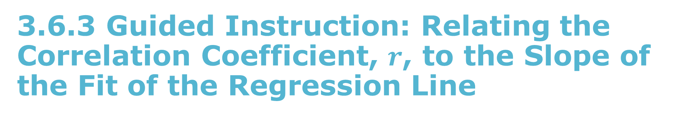
3.6.3 Guided Instruction: Relating the Correlation Coefficient, $r$, to the Slope of the Fit of the Regression Line
The screenshot of the line Tess formally fit to the data using technology included a statistic, 𝑟.
volume 1, pg. 140

Slide 18


The statistic, 𝑟, is the correlation coefficient. It measures the strength and direction of the linear association between the variables in a set of bivariate numerical data.
The correlation coefficient, $r$, is a unitless value between $−1$ and $1$.
A correlation coefficient of $1$ represents a perfect linear relationship with a positive direction.
A correlation coefficient of $−1$ represents a perfect linear relationship with a negative direction.
The closer the correlation coefficient is to $0$, the weaker the linear association between the variables.
volume 1, pg. 140

Slide 19
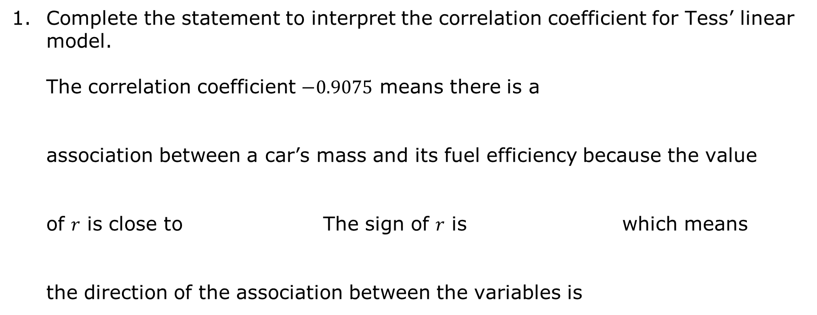
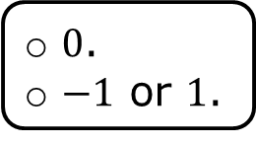
Complete the statement to interpret the correlation coefficient for Tess’ linear model.
The correlation coefficient $−0.9075$ means there is a association between a car’s mass and its fuel efficiency because the value of 𝑟 is close to The sign of 𝑟 is which means the direction of the association between the variables is
weak
strong
linear
nonlinear
$0$.
$−1$ or $1$.
positive,
negative,
positive.
negative.
volume 1, pg. 141

Slide 20
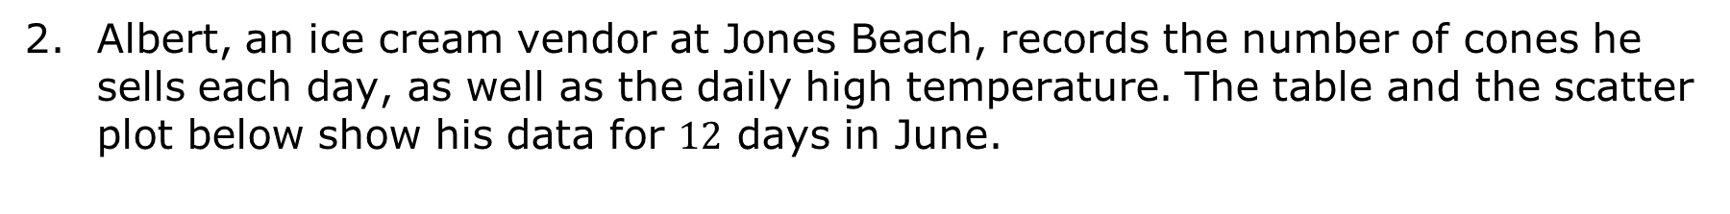
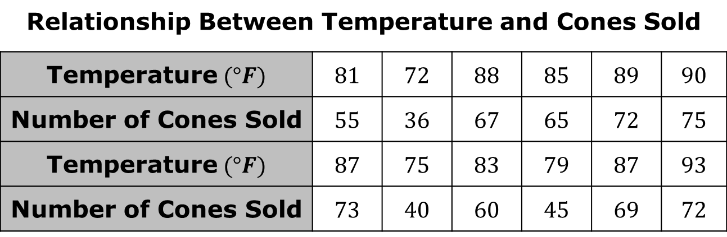
Albert, an ice cream vendor at Jones Beach, records the number of cones he sells each day, as well as the daily high temperature. The table and the scatter plot below show his data for $12$ days in June.
Relationship Between Temperature and Cones Sold
Temperature$(°F)$ | $$81$$ | $$72$$ | $$88$$ | $$85$$ | $$89$$ | $$90$$
Number of Cones Sold | $$55$$ | $$36$$ | $$67$$ | $$65$$ | $$72$$ | $$75$$
Temperature$(°F)$ | $$87$$ | $$75$$ | $$83$$ | $$79$$ | $$87$$ | $$93$$
Number of Cones Sold | $$73$$ | $$40$$ | $$60$$ | $$45$$ | $$69$$ | $$72$$
volume 1, pg. 141

Slide 21
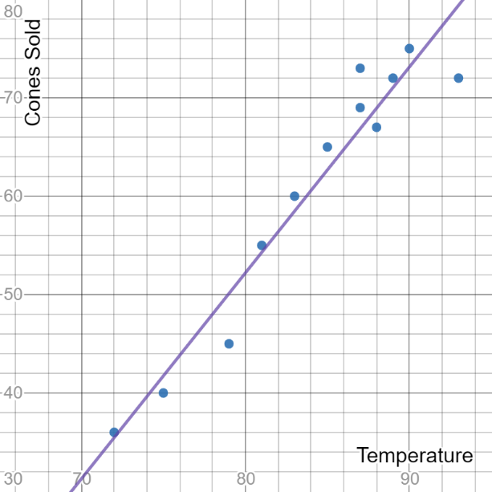
The equation of the line of best fit for this data is $y=2.0925x−115.195$ with a correlation coefficient $r=0.9646$.
volume 1, pg. 141

Slide 22
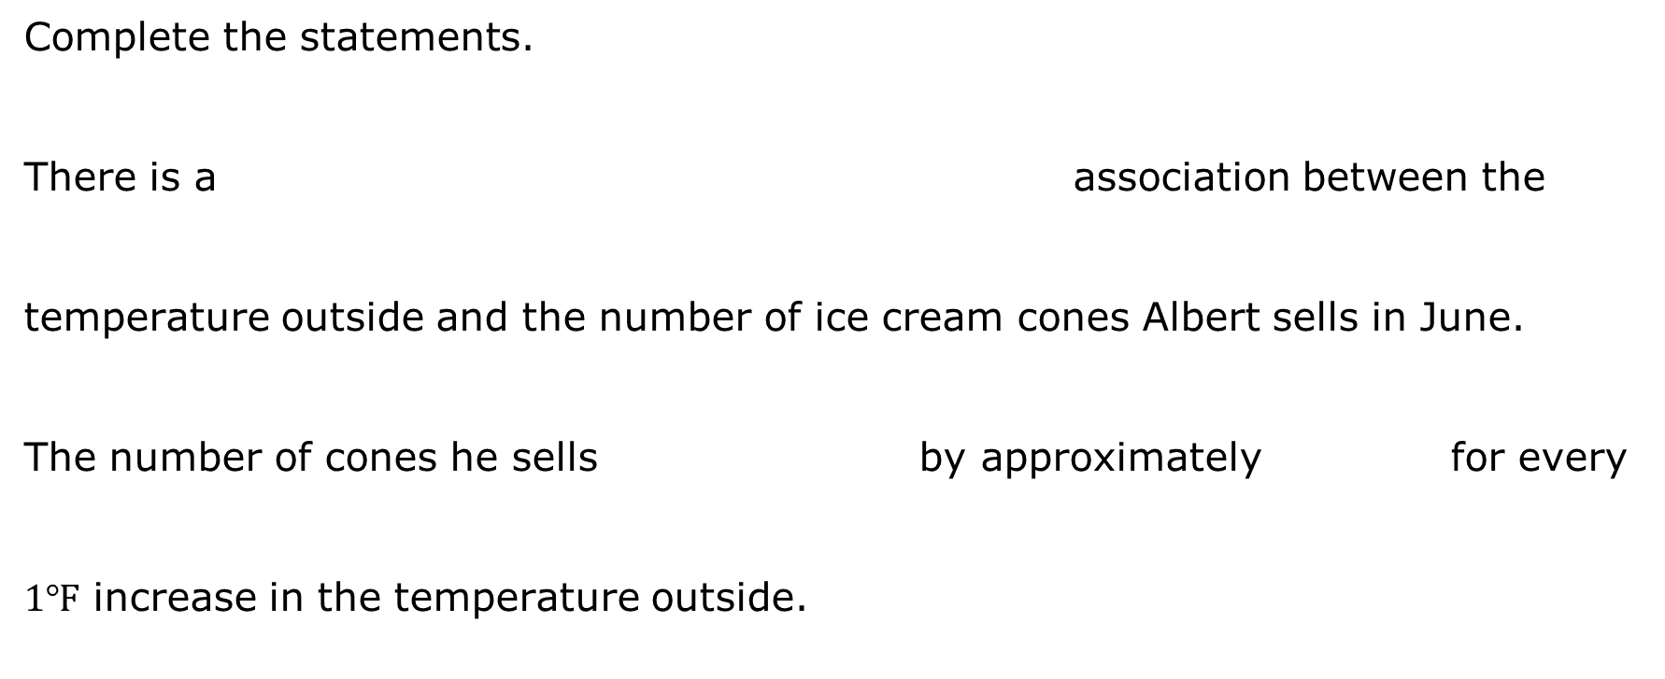
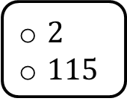
Complete the statements.
There is a association between the temperature outside and the number of ice cream cones Albert sells in June. The number of cones he sells by approximately for every $1$℉ increase in the temperature outside.
weak,
strong,
positive,
negative,
linear
nonlinear
increases
decreases
$2$
$115$
volume 1, pg. 142

Slide 23

Guided Practice
volume 1, pg. 142

Slide 24

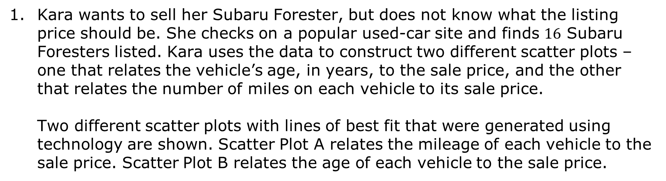
3.6.4 Guided Practice: Formally Fitting a Line of Best Fit to Data and Using it to Solve Problems
Kara wants to sell her Subaru Forester, but does not know what the listing price should be. She checks on a popular used-car site and finds $16$ Subaru Foresters listed. Kara uses the data to construct two different scatter plots – one that relates the vehicle’s age, in years, to the sale price, and the other that relates the number of miles on each vehicle to its sale price.
Two different scatter plots with lines of best fit that were generated using technology are shown. Scatter Plot A relates the mileage of each vehicle to the sale price. Scatter Plot B relates the age of each vehicle to the sale price.
volume 1, pg. 142

Slide 25
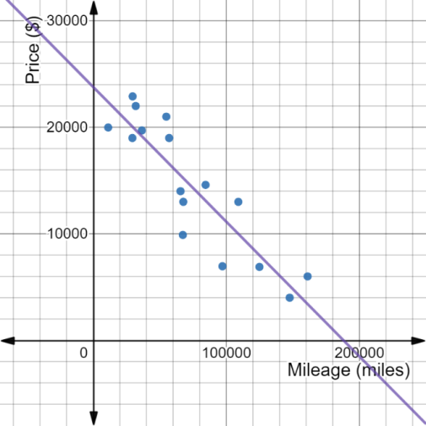
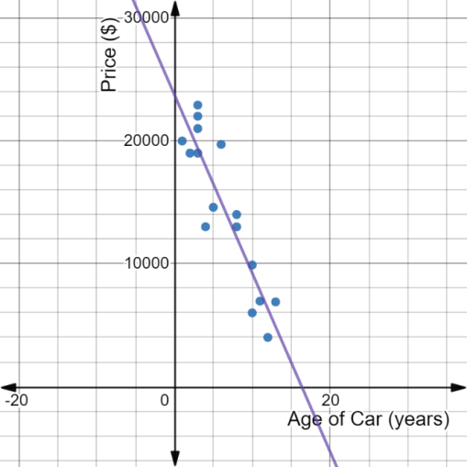
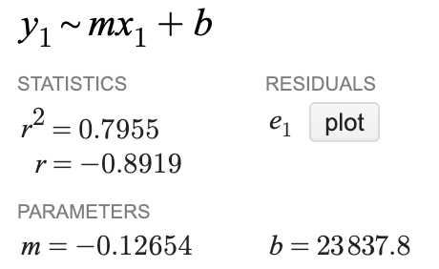
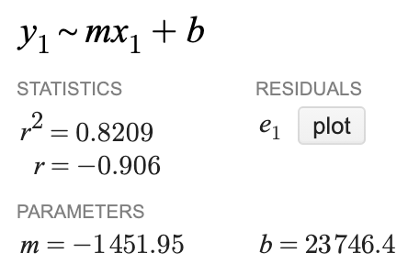
Scatter Plot A | Scatter Plot B
volume 1, pg. 142

Slide 26
Write the equation for each line of best fit using the values generated with technology.
Interpret the slope of the line of best fit for Scatter Plot B.
Describe the strength and direction of the linear association between mileage and sale price of a used Subaru Forester.
Line of Best Fit for Scatter Plot A | Line of Best Fit for Scatter Plot B
volume 1, pg. 143

Slide 27
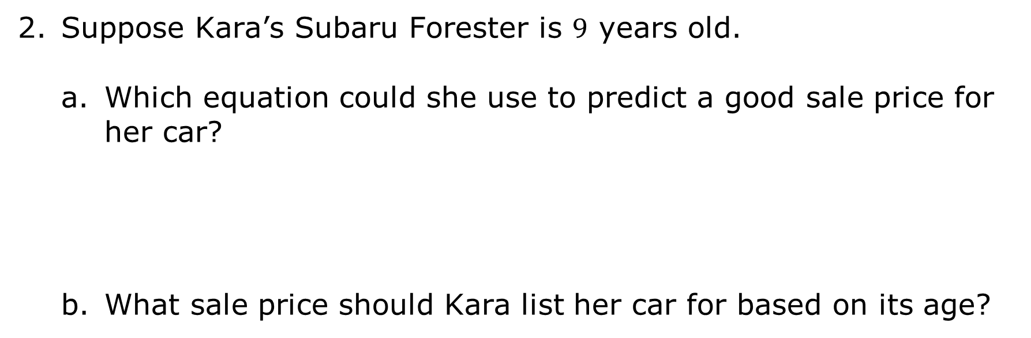
Suppose Kara’s Subaru Forester is $9$ years old.
Which equation could she use to predict a good sale price for her car?
What sale price should Kara list her car for based on its age?
volume 1, pg. 143

Slide 28

Wrap-Up
volume 1, pg. 143

Slide 29
3.6.5 Wrap-Up: Reflection
Complete each statement.
After today’s lesson, I am still unsure about ...
To fill in this gap, I intend to ...
volume 1, pg. 143

